Slide 1
Terrain Erosion in Voxels CGT 620 checkpoint 3
Yuanpei Zhao
zhao1023@purdue.edu

Slide 2
Expected Result
Try to allow users to interactively add water by pressing button
Optimization and debug
Outcome: An interactive modeling of terrains which contains multiple layers of terrain materials and shows water erosion

Slide 3
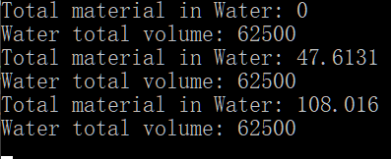
Debug
Revise water simulation equations to avoid water leaking
Instead of doing erosion and deposition check every frame, do it every p frames ---- because water on the boundary has very large volume of material and need several frames to transport

Slide 4
Optimization
Besides the original material transform model, add a concentration-based model
Very alike shallow water pipe model
Compute “outflow” based on concentration and then transform

Slide 5
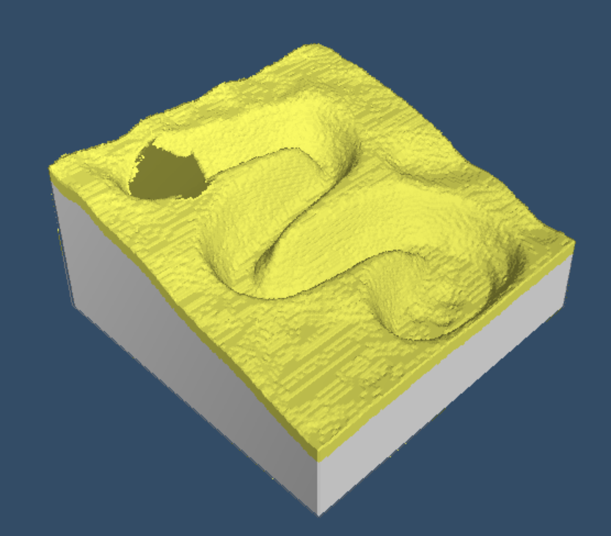
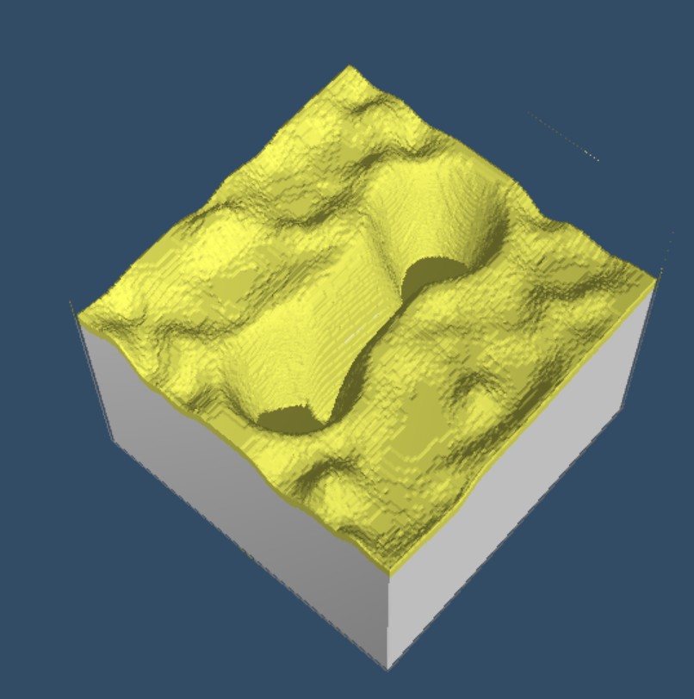
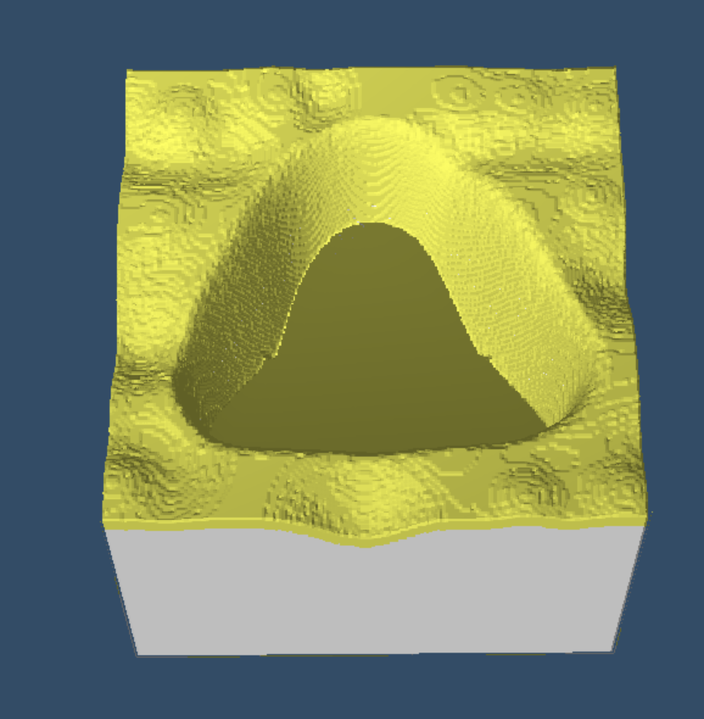
Optimization
Add 3 natural scenes

Slide 6
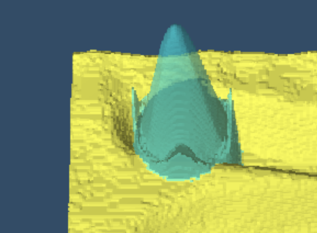
Optimization
Make water transparent

Slide 7
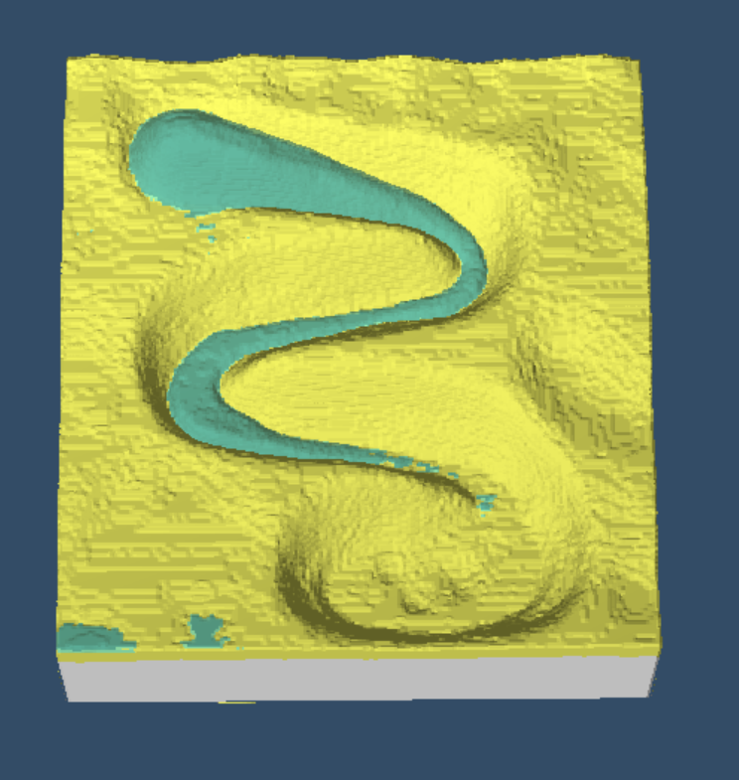
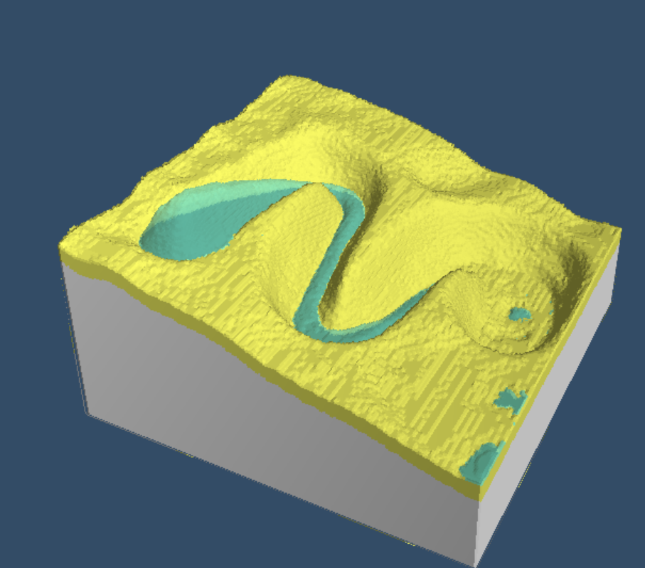
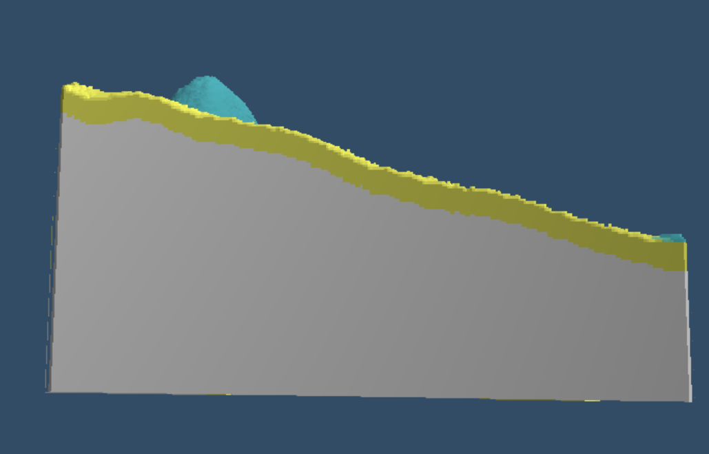
Optimization
Make free camera

Slide 8
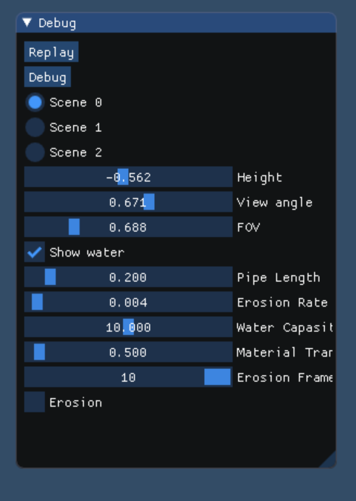
Optimization
Add GUI to control parameters

Slide 9
Result
An interactive modeling of terrains which contains multiple layers of terrain materials and shows water erosion

